Slide 1
Azure Cost Management

Slide 2




About Me
Director of Data Management for LifePoint Health
Email - Dorsey.Dustin@att.net
LinkedIn – linkedin.com/in/dustindorsey
Twitter - @SQL_DD
Blog - https://dustindorsey.com/
Github - https://github.com/dustin-dorsey
Speaker and struggling blogger
Co-lead Nashville SQL User group and SQLSaturday
Notes:
Agenda

Slide 3
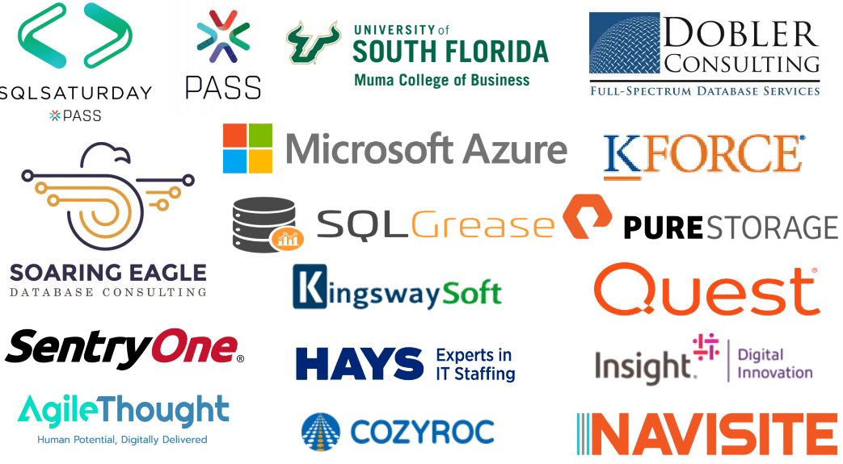

Slide 4
Agenda
Discuss why we should care about cost management
Discuss the principles of Azure governance and considerations to take beforehand
Look at Cost Management in the Azure Portal including cost analysis, budgets, alerting and more
Look at additional items to save you money that you may not be using
Notes:
Agenda
Cost Management is both a name for something in the portal and of a concept

Slide 5

Why Should You Care?
Every architectural decision that we make in the cloud has a cost tied to it!
Notes:
** Conversational slide. From here talk about how cost management is becoming an important role **’’
Costs is one of the leading factors that keep people from moving to the cloud or influence their decision to move out
According to a recent survey by IHS and Fortinet, 74% of 350 Enterprise companies they polled stated they moved back to on-premise. One of the reasons is the cost-effectiveness
https://www.fortinet.com/blog/industry-trends/ihs-markit-fortinet-cloud-report-insights.html
IDC reported 81% … 85% of these planning to move more
Managing and controlling costs is one of the top data management priorities as listed by half of the companies surveyed
Every architectural decision that we make in the cloud has a cost tied to it.

Slide 6
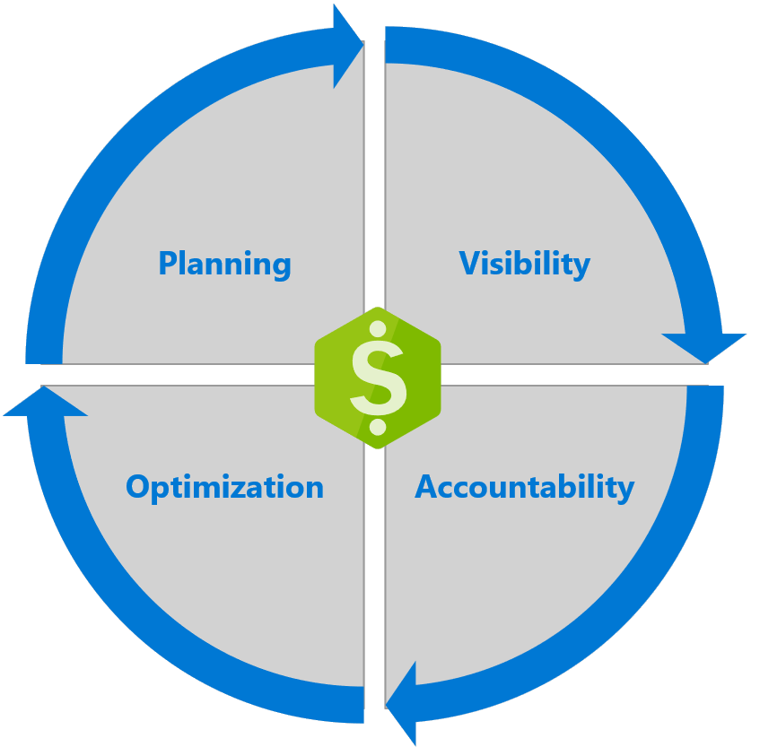
Introduction to Azure Cost Management
Proper Planning
Cost Visibility
Driving Accountability
Cost Optimization
Notes:
When we talk about cost management, we focus on 4 core tenets:
* Proper Planning – Governance and due diligence
* Ensuring cost visibility so everyone is aware of the financial impact their solutions have.
* Driving accountability throughout the organization to stop bad spending patterns.
* Continuous cost optimization as your usage changes over time to do more with less.
This is Microsoft’s guidelines for talking through what Azure Cost Management is

Slide 7

Proper Planning
“By failing to prepare, you are preparing to fail”
- Benjamin Franklin
Good Governance starts with good planning!

Slide 8
Planning Migration to the Cloud
Building estimates and understanding how they impact the costs
Architecture decisions
Azure Calculator
Azure TCO Calculator
Azure DTU calculator
Cost saving programs
Azure Migrate
Etc.

Slide 9
What Does Cloud Governance Mean?
Refers to the ongoing process of managing, monitoring, and auditing the use of Azure resources to the meet the goals and requirements of your organization
Notes:
Basically, this is creating a strong foundation

Slide 10

Azure Governance Considerations
Resource Organization
Resource Security
Auditing
Cost Controls
Notes:
Resource Organization – Subscriptions, Resource Groups, Management Groups, Tags, Naming Standards
Resource Security – RBAC, Azure Policy, Resource Lock
* Avoid bad cost decisions by making sure you have proper security controls in place
The foundation for good cost management starts with a strong foundation
Ownership and permissions
RBAC
Principle of least privilege
Avoid unnecessary costs

Slide 11

What are Tags?
Tags are metadata that can be added to an Azure resource. They allow you to be able to quickly organize resources based on your own criteria.
Notes:
Tags
Way to attribute and filter cost
Set Expiration dates
Metadata attached to a resource
Caps at 15
Using descriptive resources names are great practice, but you are still limited there. You may still use tags overlapping what is already covered in the name
Lifecycle management
Removing and discovering items not in use
Tag resources with an expiration date
Demo of Tags and how to add them

Slide 12
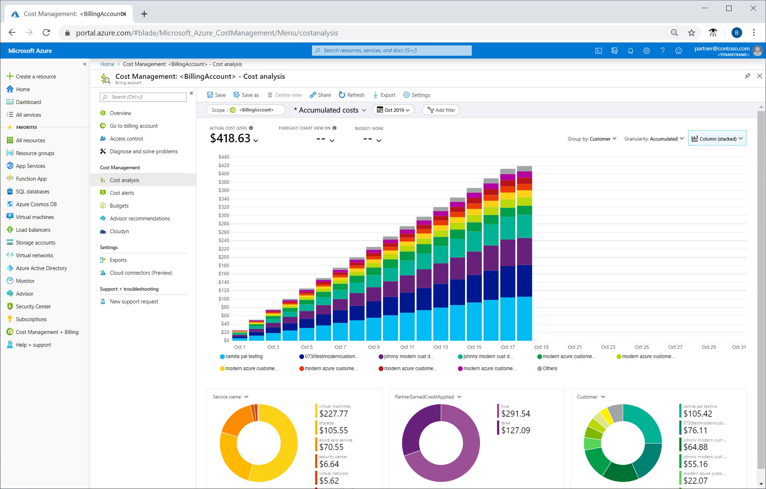
Azure Cost Management in the Portal

Slide 13

Not Available (Yet) With Some Microsoft Offers
Notable exclusions are Cloud Solution Providers (CSP)
For full list of those include and excluded you can view this link - https://docs.microsoft.com/en-us/azure/cost-management-billing/costs/understand-cost-mgt-data
Notes:
List of exclusions
Category Offer name
Azure Germany Azure Germany Pay-As-You-Go
Azure Government Azure Government Pay-As-You-Go
Cloud Solution Provider (CSP) Microsoft Azure
Cloud Solution Provider (CSP) Azure Government CSP
Cloud Solution Provider (CSP) Azure Germany in CSP for Microsoft Cloud Germany
Pay-As-You-Go Azure for Students Starter
Pay-As-You-Go Azure for Students4
Pay-As-You-Go Microsoft Azure Sponsorship
Support Plans Standard support
Support Plans Professional Direct support
Support Plans Developer support
Support Plans Germany support plan
Support Plans Azure Government Standard Support
Support Plans Azure Government Pro-Direct Support
Support Plans Azure Government Developer Support

Slide 14



What are Scopes?
Is a node in the Azure resource hierarchy where Azure AD users access and manage services
Billing Account, Management Group, Resource Group, Department, etc.
Scope will vary based on your type of account
Notes:
Lifecycle management
Removing and discovering items not in use
Tag resources with an expiration date
Resource on final slides

Slide 15
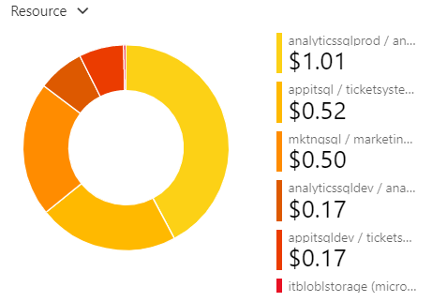
Cost Analysis Features
Analyze costs in various ways
Forecast spends
View spend against budgets
Save and share views
Scheduled exports to Blob storage
Notes:
Do you need to import your billing data into an external system, like a dashboard or financial system? Set up automated exports to Azure Storage and avoid manually downloading files every month. You can then easily set up automatic integrations with other systems to keep your billing data in sync.

Slide 16
How to Use Cost Analysis
Estimated Costs
How much have I spent? Am I on track to stay under budget?
Investigate Anomalies
How am I trending? Is there anything unusual?
Invoice Comparisons
How does my spend this month compare to last? Did my spending habits change?
Internal Chargeback
How should my charges be broken down for my organization
Notes:
Cost analysis allows you to analyze your organizational costs in-depth by slicing and dicing your costs.
This slide shows examples of how your costing.

Slide 17
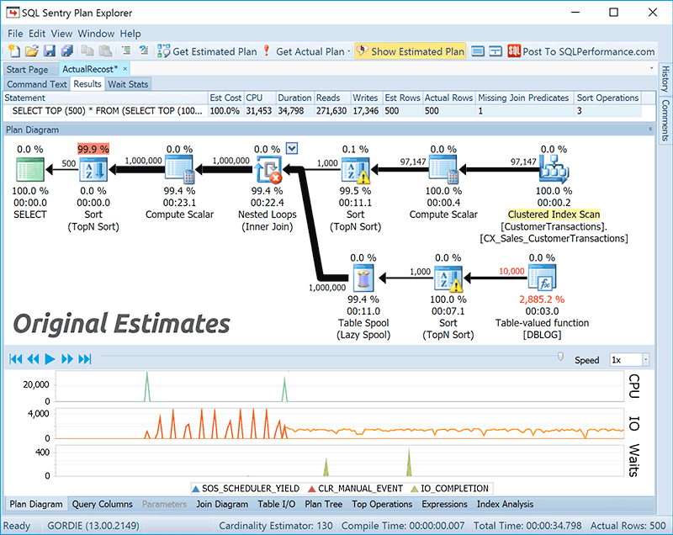
Pro-Active Performance Tuning!
Performance tuning now produces immediate cost savings!
Notes:
Skills are more valuable then ever!

Slide 18

What are Budgets?
Allows you to track your spending against budgets and create accountability. When you hit a specified threshold you can automate actions.
Notes:
Budgets in Cost Management help you plan for and drive organizational accountability. With budgets, you can account for the Azure services you consume or subscribe to during a specific period. They help you inform others about their spending to proactively manage costs, and to monitor how spending progresses over time
https://docs.microsoft.com/en-us/azure/cost-management-billing/manage/cost-management-budget-scenario
After you've identified and analyzed your spending patterns, it's important to begin setting limits for yourself and your teams. Azure budgets give you the ability to set either a cost or usage-based budget with many thresholds and alerts. Make sure to review the budgets that you create regularly to see your budget burn-down progress and make changes as needed. Azure budgets also allow you to configure an automation trigger when a given budget threshold is reached. For example, you can configure your service to shut down VMs. Or you can move your infrastructure to a different pricing tier in response to a budget trigger.

Slide 19




List of Action Groups
Automation Run Books
Email/Push/SMS/Voice
Email Azure Resource Manager Role
Azure Functions
ITSM
Logic App
Webhook
Notes:
Automation run books – automate Azure management tasks – Powershell, Python, etc
Email Azure Resource Manager Role – Send email to the members of the subscription's role
Azure Functions - is a serverless compute service that lets you run event-triggered code without having to explicitly provision or manage infrastructure
ITSM – Integrate with work tracking systems (SCCM, ServiceNow, etc.)
Logic Apps - a cloud service that helps you schedule, automate, and orchestrate tasks, business processes, and workflows when you need to integrate apps, data, systems, and services across enterprises or organizations
Webhook - an addressable HTTP or HTTPS endpoint that allows external applications to communicate with your system

Slide 20

Azure Advisor
Analyzes your Azure usage and provides recommendations on changes you can make to save money, improve performance, strengthen security and improve reliability
Notes:
is a free service that analyzes your Azure usage and provides recommendations on how you can optimize your Azure resources to reduce costs, boost performance, strengthen security, and improve reliability
Azure Advisor is a service that, among other things, identifies virtual machines with low utilization from a CPU or network usage standpoint. From there, you can decide to either shut down or resize the machine based on the estimated cost to continue running the machines. Advisor also provides recommendations for reserved instance purchases. The recommendations are based on your last 30 days of virtual machine usage. When acted on, the recommendations can help you reduce your spending.

Slide 21

What is Cloudyn?
Cloudyn was purchased by Microsoft in 2017 and became the foundation for Azure Cost Management. Functionality has been migrated over and this will likely be retired this year.
Notes:
Agenda

Slide 22



Multi-Cloud Tool
Azure Cost Management is FREE for Azure users
You can also use this to monitor your AWS spends for 1% of your total cost
GCP on the roadmap
Single pane of glass for hybrid cloud users
Notes:
Agenda

Slide 23
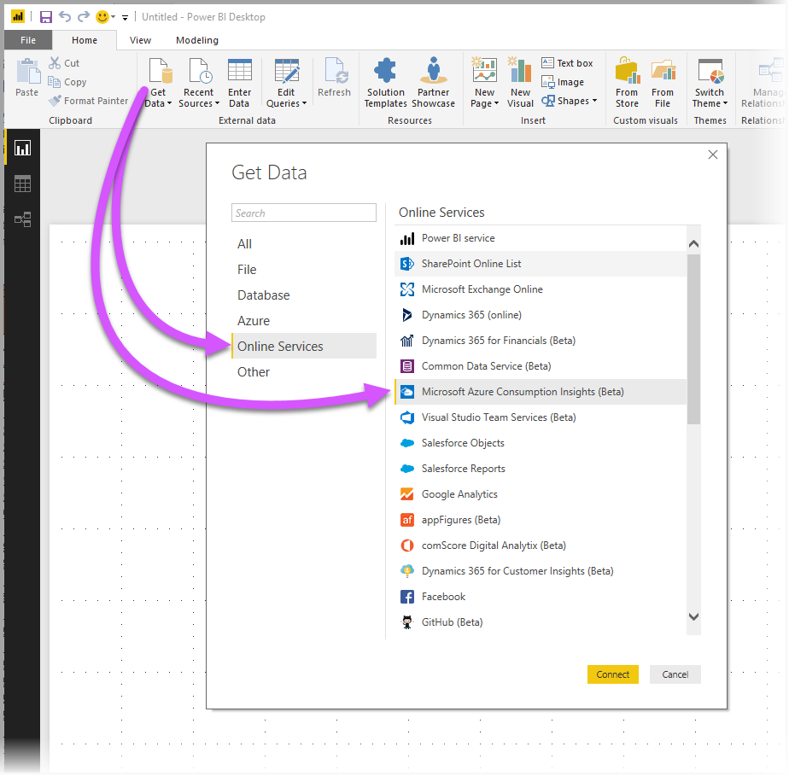
Azure Consumption Insights in PowerBI
This allows access to cost and usage data for your Azure resources
https://docs.microsoft.com/en-us/power-bi/desktop-connect-azure-consumption-insights
Notes:
You can use Power BI desktop to connect to Azure and get in-depth data about your organization's Azure service usage. With this data, you can create custom reports and measures to better understand and analyze your Azure spend.

Slide 24

Tips to Help Lower Costs
Utilize reserved pricing
Azure Hybrid Benefit
Manage runtime hours
Stop to think if there is a better way to do this
Remove\turn off things you do not need
Take advantage of offered Microsoft Programs
Utilize Dev\Test Pricing
Notes:
Ways to control costs:
Utilize reserved pricing (commitment of 1 or 3 years) can have significant cost savings.
2. Azure Hybrid Benefit – This allows you to bring on-prem Windows and SQL licenses to the cloud
3. Use running hours as a way to control cost. By default everything is 730 hours a month which means 24/7.
4. Really consider what you are building and if there is better way. If you are building a VM is there an opportunity to take advantage of a Paas offering.
5. Remove\turn off things you not need
* Be sure to look back on unused resources in Azure to make sure you are not paying for things you are not using. Have seen virtual machines get deleted, but the disks and stored data remain active which incurs obsolete costs. Public IP’s no longer attached to anything can also incur charges. Old objects, evens ones without a cost, can still create a cluster

Slide 25
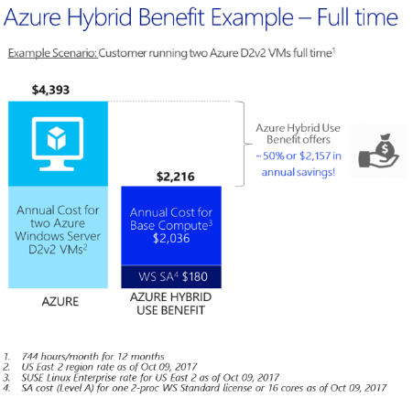
Azure Hybrid Benefit
Is a pricing offer that allows you to take your existing on-prem licenses for Windows and SQL Server to Azure
Azure Hybrid Benefit Calculator
https://azure.microsoft.com/en-us/pricing/hybrid-benefit/
Notes:
https://docs.microsoft.com/en-us/windows-server/get-started/azure-hybrid-benefit

Slide 26
Important Notes About SQL Azure Hybrid Benefit
All on-prem rules still apply unless specifically noted
1 Enterprise license (2 Cores) = 4 Standard licenses (8 cores) for general purpose (x4 multiplier)
Standard licenses are 1:1
1 Enterprise license (2 Cores) = 1 Enterprise licenses (2 Cores) for business critical
Cannot use Standard licenses for business critical
180 days of dual use for migration purposes only
HA/passive rules still apply
Must have SA to move licenses to Azure and must maintain it to retain this benefit
Option to use host-based licensing with Azure Dedicated Host (currently in Preview)
Notes:
1 Enterprise license (2 Cores) = 4 Standard licenses (8 cores) for general purpose (x4 multiplier)
1 Enterprise license (2 Cores) = 1 Enterprise licenses (2 Cores) for business critical
180 days of dual use for migration purposes only
License cannot be reassigned for 90 days
HA/passive rules still apply
Must have SA to move licenses to Azure and must maintain it to retain this benefit
Azure Dedicated Host - Currently in Preview

Slide 27

Azure Reservations
Azure Reservations help you save money by committing to one-year or three-years plans
Notes:
Azure Reservations help you save money by committing to one-year or three-years plans for virtual machines, Azure Blob storage or Azure Data Lake Storage Gen2, SQL Database compute capacity, Azure Disk Storage, Azure Cosmos DB throughput, or other Azure resources. Committing allows you to get a discount on the resources you use. Reservations can significantly reduce your resource costs up to 72% on pay-as-you-go prices. Reservations provide a billing discount and don't affect the runtime state of your resources.
You can pay for a reservation up front or monthly. The total cost of up-front and monthly reservations is the same and you don't pay any extra fees when you choose to pay monthly. Monthly payment is available for Azure reservations, not third-party products.

Slide 28

Azure Dev\Test Pricing
Reduced costs on Azure resources exclusively for development and testing.
Visual Studio Subscriptions is required to take advantage of this offer.
https://azure.microsoft.com/en-us/offers/ms-azr-0148p/
Notes:
https://azure.microsoft.com/en-us/offers/ms-azr-0148p/
Option 1: For Individuals – Credits given for Visual Studio Subscribers
Option 2: For Teams (Enterprise Agreement customers)
Option 3: For Teams PAYG
Or Feedback and acceptance testing users

Slide 29
Resources
Azure Cost Management + Billing documentation - https://docs.microsoft.com/en-us/azure/cost-management-billing/
Scopes - https://docs.microsoft.com/en-us/azure/cost-management-billing/costs/understand-work-scopes
Power BI Azure Consumption Insights - https://docs.microsoft.com/en-us/power-bi/desktop-connect-azure-consumption-insights
Dev\Test Subscriptions - https://azure.microsoft.com/en-us/offers/ms-azr-0148p/
Azure Reservations - https://docs.microsoft.com/en-us/azure/cost-management-billing/reservations/save-compute-costs-reservations
Notes:
Agenda

Slide 30
Resources (cont’d)
Azure Cloud Governance - https://docs.microsoft.com/en-us/azure/cloud-adoption-framework/govern/guides/index
Monitoring AWS - https://docs.microsoft.com/en-us/azure/cost-management-billing/costs/aws-integration-manage
Management Groups - https://docs.microsoft.com/en-us/azure/governance/management-groups/overview
Notes:
Agenda

Slide 31
API Resources
Azure Consumption Insights API - https://docs.microsoft.com/en-us/azure/cost-management-billing/manage/consumption-api-overview
Azure Billing API’s - https://docs.microsoft.com/en-us/azure/cost-management-billing/manage/usage-rate-card-overview
Notes:
Azure Invoice Download API (Preview)
Azure Resource Usage API (Preview)
Azure Resource RateCard API (Preview)
Azure Billing REST API
Azure consumption API
* Usage Details API, Marketplace Charges API, Balances API, Budgets API, Reservations Recommendations API,

